Slide 1
Google search secrets

Slide 2
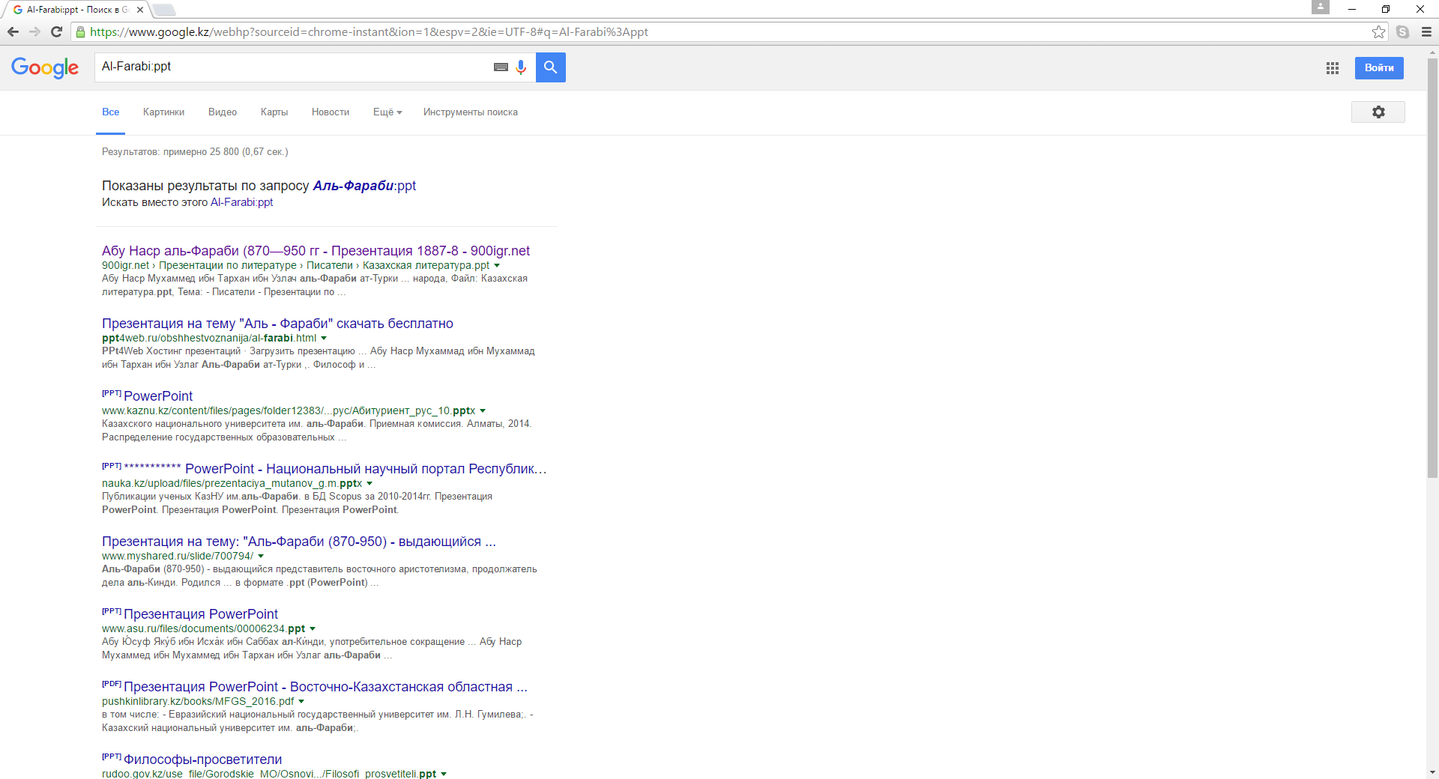
Refine Google Search by File Type (filetype)
filetype:pdf Keyword as an example –

Slide 3
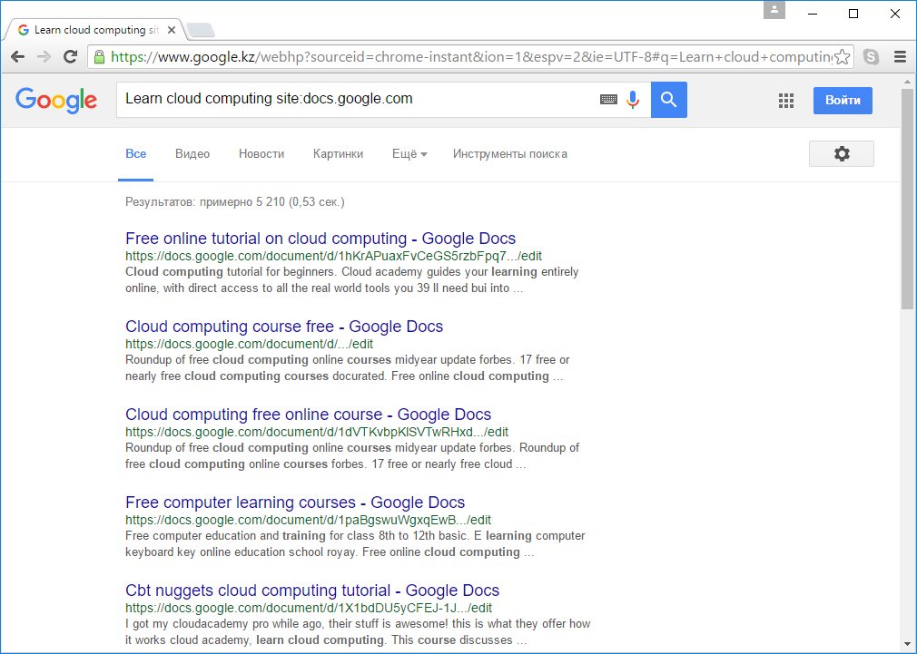
Get Result from one Website (site)
  keyword site:sitename

Slide 4
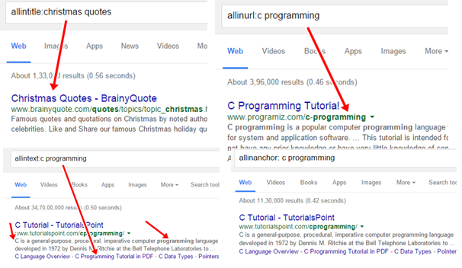
Get results containing keyword in Title, URL and Search Text
allintitle:keyword – It will show you results containing the keyword in the title of the search result.
allinurl:Keyword – Show you all results containing your keyword in result URL.
allintext:keyword – Show you all results containing your keyword in search Text.
allinanchor:keyword – Shows you links to the pages you’re looking for.

Slide 5
Remove unwanted terms from search result using “-” Operator
Let’s you are searching for Speed of Jaguar animal but whenever you search for Jaguar Speed Google will show you results related to Jaguar Car. Here you can restrict Google to not returns the result related to car using “-” operator.
Ex – Search for Jaguar Speed – Car now you won’t get car related results.

Slide 6
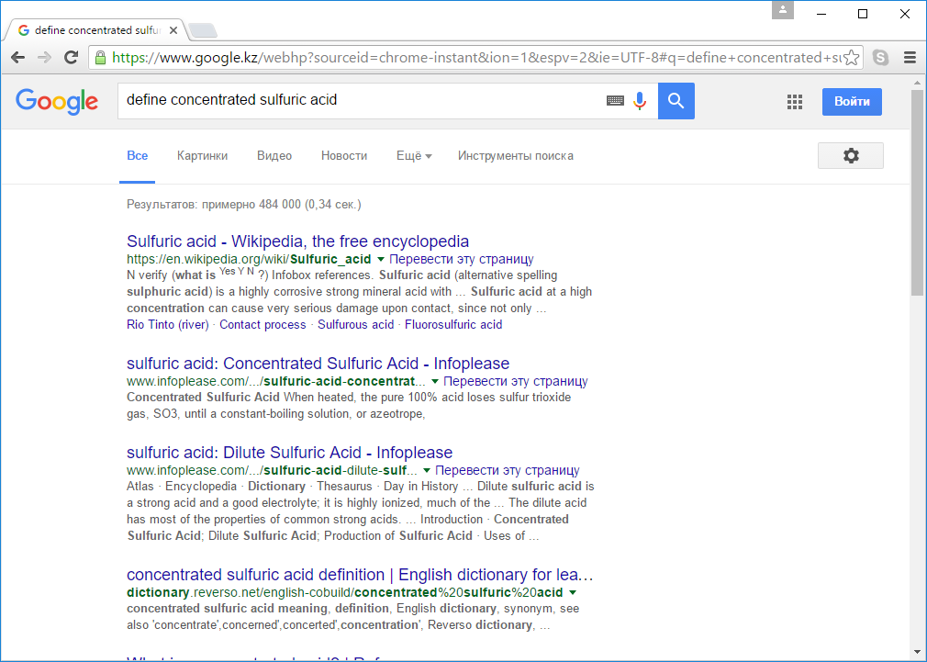
Find the definition instantly.
Whenever you need to find the definition of any word simply go to Google search and use the operator “Define” as an example “define:lol” and you will see the definition of the word at the top of search result.

Slide 7
Find Exact Phrase you are Looking For – ” (Quotes) Operator
If you want Google to result in exact phrase you are looking for use ” (Quote) Operator, this applies to 2 or more words queries, let’s you are looking for windows 10 and do a search, Google will show you result containingWindows 10, or windows or 10 here, searching “Window 10″ will result into all the pages containing Windows 10 as a phrase.

Slide 8
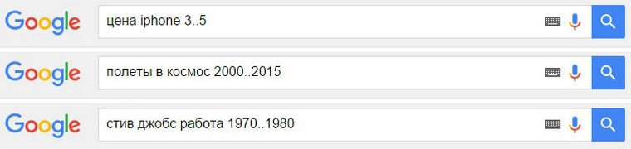
Search in some number diapason
Keyword number1..number2

Slide 9
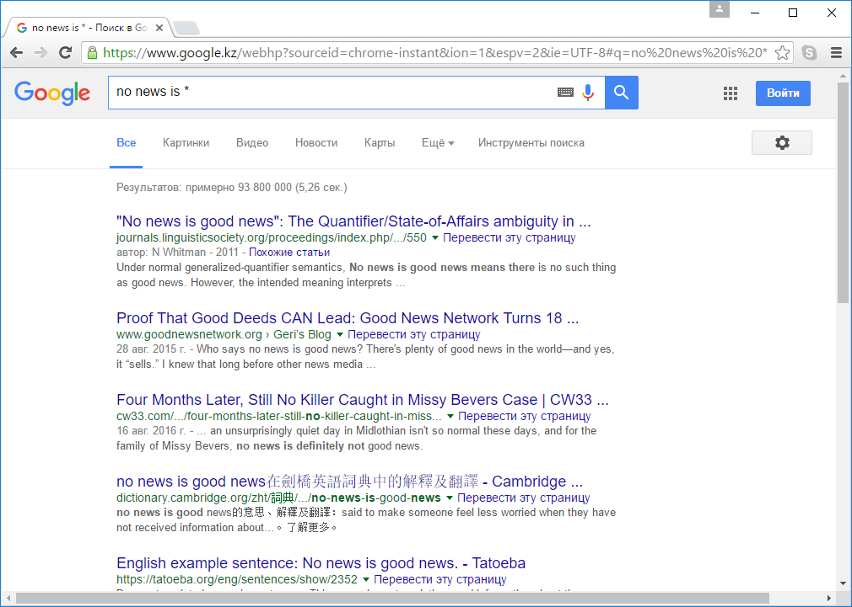
Some part of forgotten phrase
Write * instead of any forgotten word

Slide 10
Narrow down results using AND & OR operator
AND – Lets you are searching for Birds Penguin Google may return results having Birds and Penguin or only Birds or only Penguin but if you want all the results having bird & Penguin both, use AND operator as Birds AND Penguins now google will return results having both words Bird and Penguin.
OR – The OR operator tells the Google that “I only want to see results based on what I specify, but not results that have to contain all of what I specify.” For example If you search for mango OR tree it will show you results having either mango or tree, it may show you results having mango and tree in same article exceptionally.

Slide 11
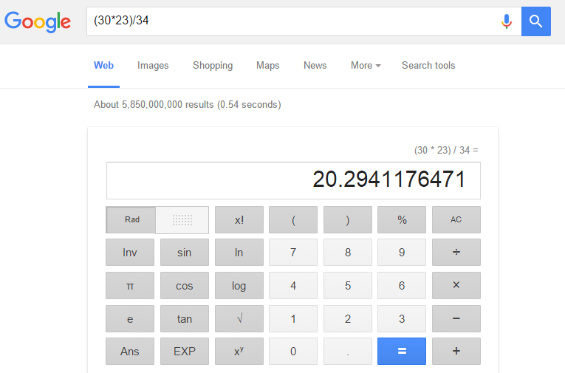
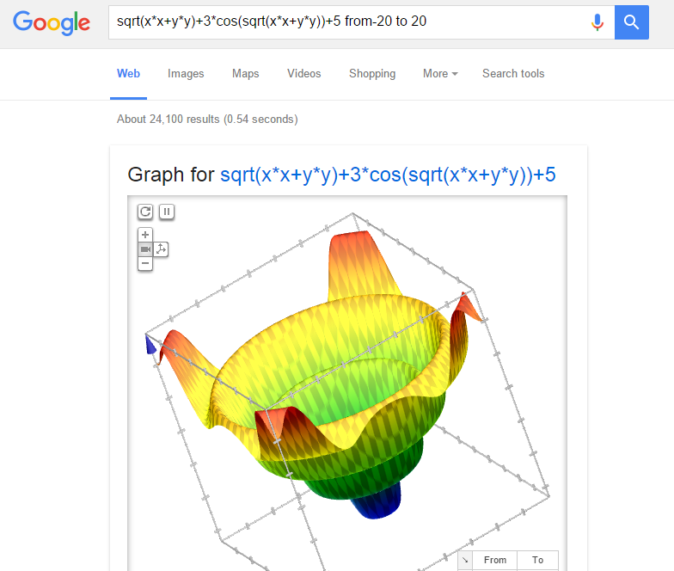
Solve mathematical problems
(30*23)/34
sqrt(xx+yy)+3cos(sqrt(xx+y*y))+5 from-20 to 20

Slide 12
Few More Google Search Trick
Opening www.google.com/ncr will take you to .com site (NCR- No country redirect)
Go to images.google.com drag and drop any image from the computer for reverse image lookup.
www.goo.gl is a URL shortener by Google, also give you analytics of shorten URLs.
books.google.com is a library of different books.
Find related site as related:amazon.com
Compare foods using Vs as Pizza Vs Burger and get all information like calories, fat etc.
Get the news in a specific location search in Google News as Star wars location:California.
Type Timer for a quick timer, Type Stopwatch and you will get a stopwatch running on Google.
Convert numbers into words as 12946 into words and get words written, easily copy paste anywhere.
Convert Currencies as 10 Dollar in INR.

